Slide 1

Transition Graphs
John P. Baugh, Ph.D. CIS 306 – University of Michigan – Dearborn Winter 2021

Slide 2
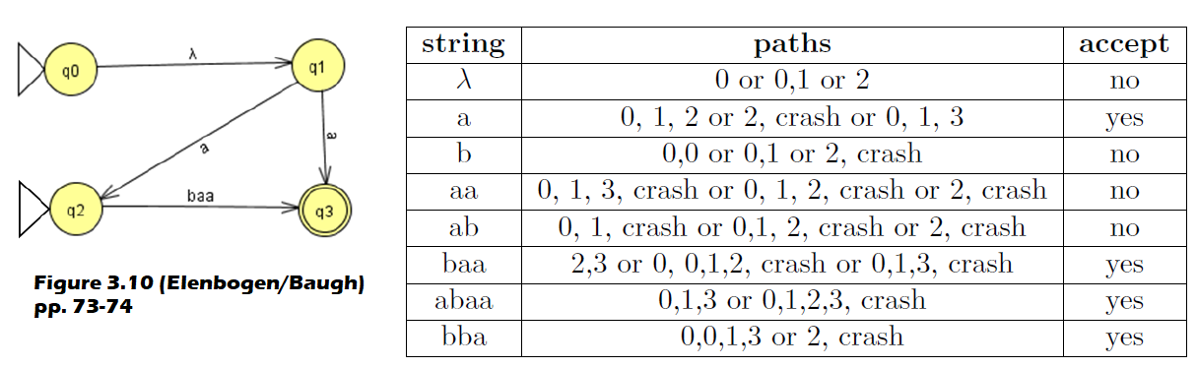
Figure 3.10 (pp. 73-74)
Ooops

Slide 3
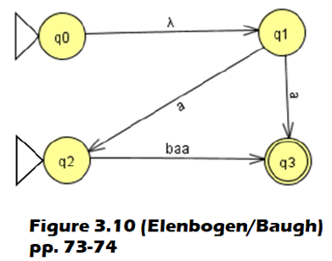
Corrected Version
String | Paths | Accept?
λ
a
b
aa
ab
baa
abaa
bba

